Slide 1
OVERVIEW OF DATABASE DESIGN

Slide 2
The database design process can be divided into six steps. The ER model is most relevant to the first three steps.

Slide 3
The database design process can be divided into six steps. The ER model is most relevant to the first three steps.
Requirements Analysis : In a nut shell what the users want from the database.
Conceptual Database Design: gathered in the requirements analysis step is used to develop a high-level description of the data to be stored in the database : Where ER model comes in to place.

Slide 4
The database design process can be divided into six steps. The ER model is most relevant to the first three steps.
Requirements Analysis : In a nut shell what the users want from the database.
Conceptual Database Design: Information gathered in the requirements analysis step is used to develop a high-level description of the data to be stored in the database : Where ER model comes in to place.
Logical Database Design: Choosing a DBMS to implement our database design, convert the conceptual database design into a database schema in the data model of the chosen DBMS.

Slide 5
The database design process can be divided into six steps. The ER model is most relevant to the first three steps.
Requirements Analysis : In a nut shell what the users want from the database.
Conceptual Database Design: Information gathered in the requirements analysis step is used to develop a high-level description of the data to be stored in the database : Where ER model comes in to place.
Logical Database Design: Choosing a DBMS to implement our database design, convert the conceptual database design into a database schema in the data model of the chosen DBMS.
Schema Refinement: The fourth step in database design is to analyze the collection of relations in our relational database schema to identify potential problems, and to refine it.
Physical Database Design:

Slide 6
The database design process can be divided into six steps. The ER model is most relevant to the first three steps.
Requirements Analysis : In a nut shell what the users want from the database.
Conceptual Database Design: gathered in the requirements analysis step is used to develop a high-level description of the data to be stored in the database : Where ER model comes in to place.
Logical Database Design: Choosing a DBMS to implement our database design, convert the conceptual database design into a database schema in the data model of the chosen DBMS.
Schema Refinement: The fourth step in database design is to analyze the collection of relations in our relational database schema to identify potential problems, and to refine it.
Physical Database Design:
Security Design: identify various users and various roles played by various users and define privileges etc.

Slide 7
Entity-Relationship Model
Allows to describe the data involved in a real-world enterprise in terms of objects and their relationships.
It provides useful concepts that allow us to move from an informal description of what users want from their database to a more detailed, and precise, description that can be implemented in a DBMS.

Slide 8
Requirement analysis for a company
The company is organized into departments. Each department has a unique name, a unique number, and a particular employee who manages the department. We keep track of the start date when that employee began managing the department. A department may have several locations.
A department controls a number of projects, each of which has a unique name, a unique number, and a single location.
The database will store each employee’s name, Social Security number, address, salary, sex (gender), and birth date. An employee is assigned to one department, but may work on several projects, which are not necessarily controlled by the same department. It is required to keep track of the current number of hours per week that an employee works on each project, as well as the direct supervisor of each employee (who is another employee).
The database will keep track of the dependents of each employee for insurance purposes, including each dependent’s first name, sex, birth date, and relationship to the employee.

Slide 9
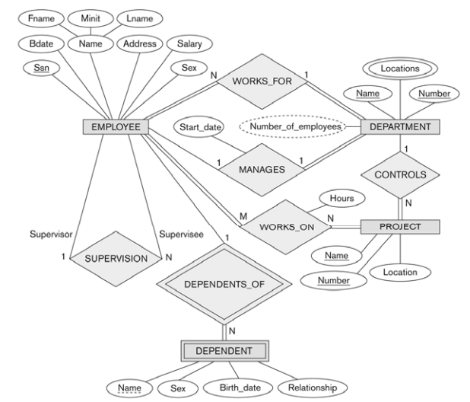

Slide 10
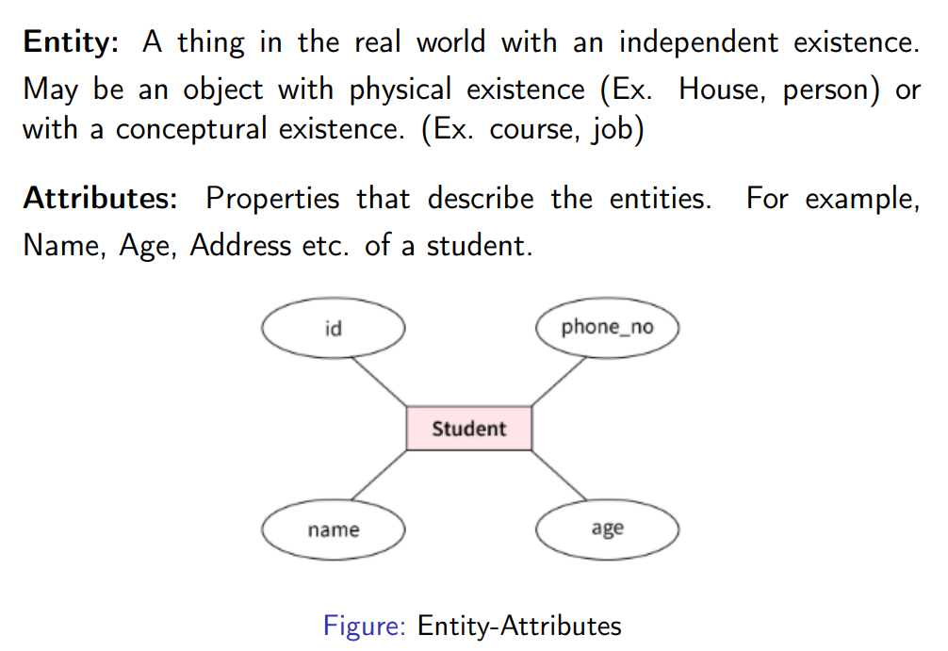
Each entity type will have a collection of entities stored in the database called the entity set

Slide 11
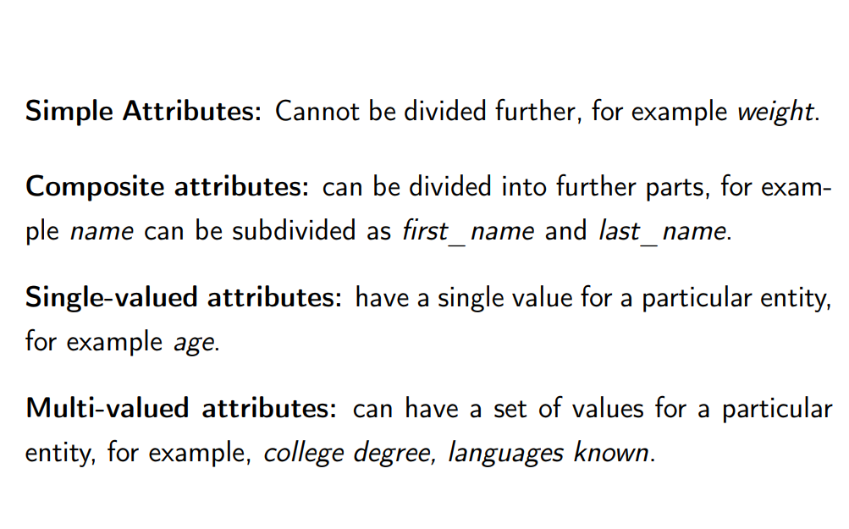
Multivalued attribute: PhoneNumber: ["555-1234", "555-5678"]

Slide 12
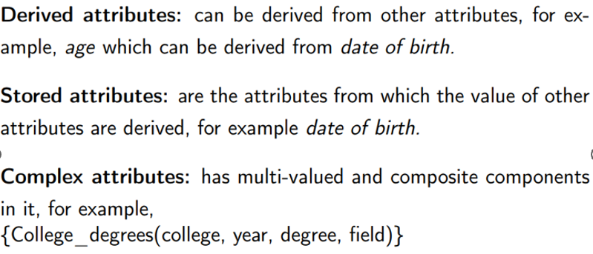

Slide 13
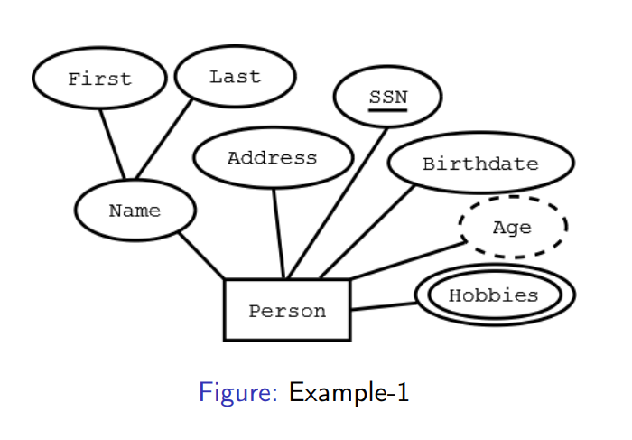
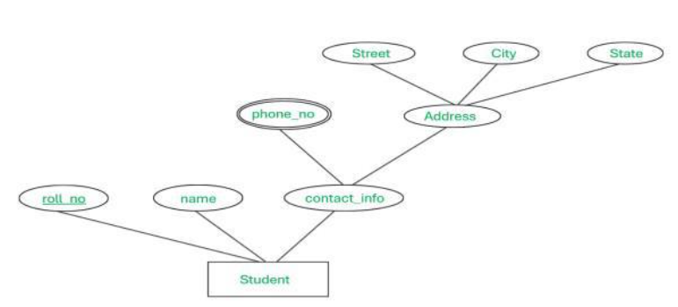

Slide 14
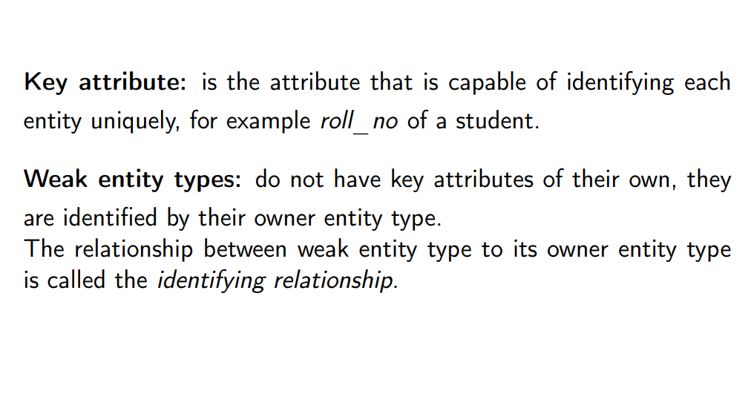

Slide 15
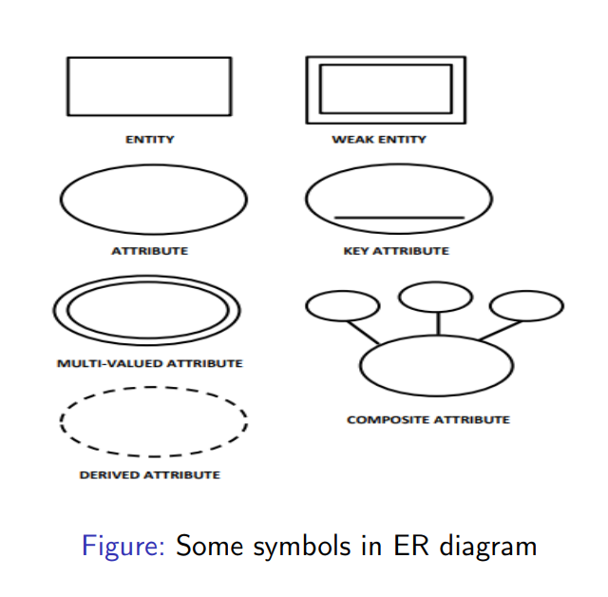

Slide 18
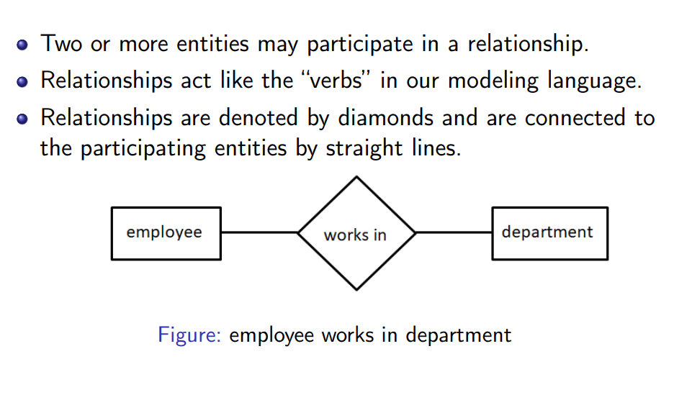
Relationships

Slide 19
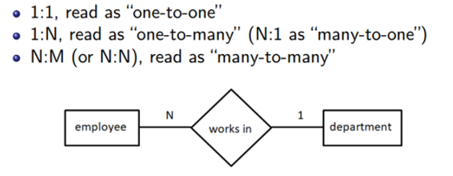
Constraints on Relationships
Cardinality ratios
Represents the maximum number of entities that can be associated with each other through relationship, R.

Slide 21
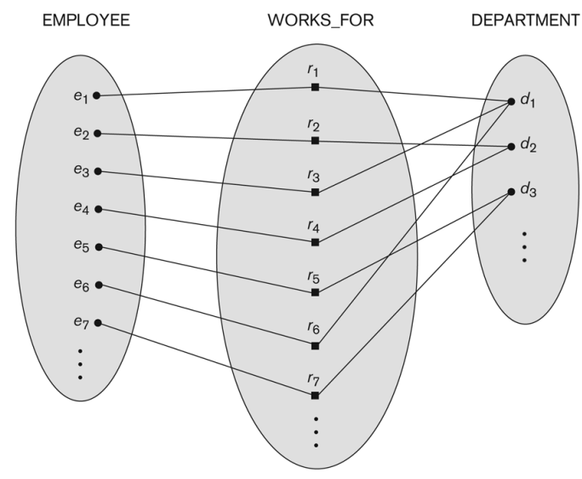
N:1

Slide 22
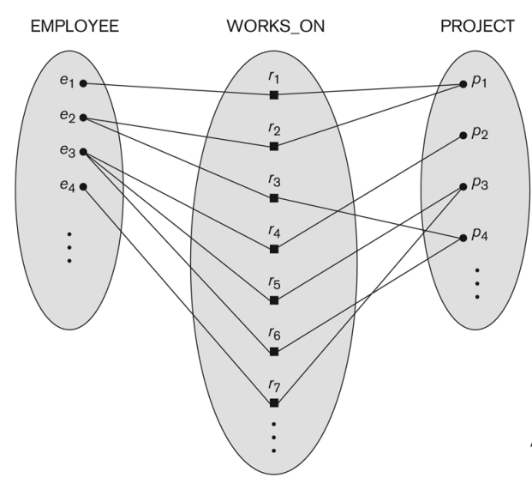
M:N

Slide 23
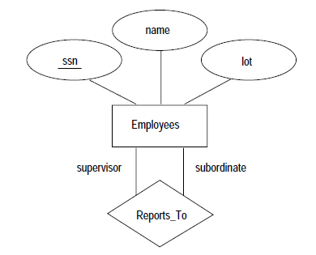
The entity sets that participate in a relationship set need not be distinct; sometimes a relationship might involve two entities in the same entity set.
For example, consider the Reports_To relationship set Since employees report to other employees, every relationship in Reports_To is of the form (emp₁,emp₂) where both emp1 and emp2 are entities in Employees.
Dr A V Prajeesh, SAS, VIT Vellore
23

Slide 24
Participation
Participation Constraints : tell us that the participation in a relationship can either be total or partial.
When each entity in an entity set participates in a relation, it is called Total Participation. However, when not all entities in the given entity set participate in a relation, it is called Partial Participation.

Slide 26
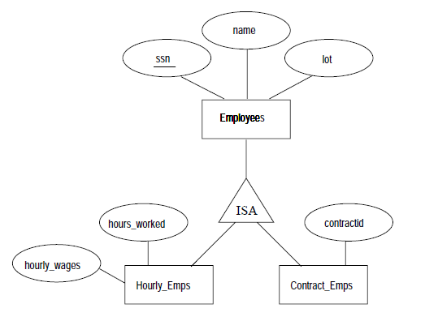
Class Hierarchies
Sometimes it is natural to classify the entities in an entity set into subclasses.
For example, we might want to talk about an Hourly Emps entity set and a Contract Emps entity set to distinguish the basis on which they are paid.
We might have attributes hours worked and hourly wage defined for Hourly Emps and an attribute contracted defined for Contract Emps.

Slide 27
We want the semantics that every entity in one of these sets is also an Employees entity, and as such must have all of the attributes of Employees defined.
Thus, the attributes defined for an Hourly Emps entity are the attributes for Employees plus Hourly Emps.
We say that the attributes for the entity set Employees are inherited by the entity set Hourly Emps, and that Hourly Emps ISA (read is a) Employees.

Slide 28
Employees is specialized into subclasses. Specialization is the process of identifying subsets of an entity set (the superclass) that share some distinguishing characteristic.
Hourly Emps and Contract Emps are generalized by Employees. As another example, two entity sets Motorboats and Cars may be generalized into an entity set Motor Vehicles.
Generalization consists of identifying some common characteristics of a collection of entity sets and creating a new entity set that contains entities possessing these common characteristics.

Slide 29
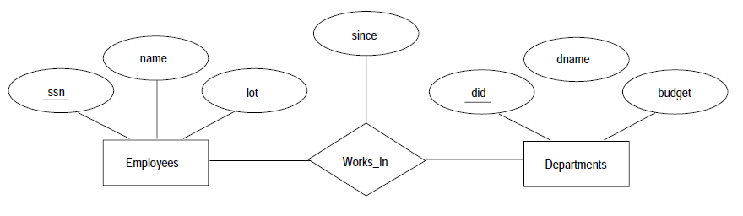
A relationship can also have descriptive attributes. Descriptive attributes are used to record information about the relationship, rather than about any one of the participating entities.
For example, we may wish to record that Arun works in pharmacy department since 1980.

Slide 30
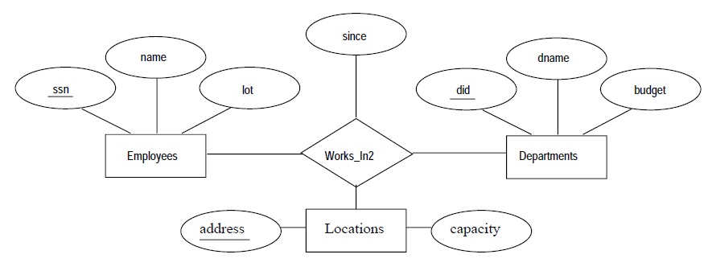
Suppose that each department has offices in several locations and we want to record the locations at which each employee works.
This relationship is ternary because we must record an association between an employee, a department, and a location.

